Slide 1
DEVELOP AN OUTCOME L2
Evidence of Learning Template
YOUR NSN NUMBER HERE
Project Title: Expense Tracker
Josh Nguyen

Slide 2
Github /Drive link
Trello board or PM link
You MUST provide evidence showing how the problem has been decomposed, how the components have been developed and trialled, and of how they have been assembled and tested to create a final, working outcome.

Slide 3
https://trello.com/invite/b/1EqrZnHl/cffb8906c471631e19c88b44aa97d4b1/project-board

Slide 4
Notes:
Planning-
Time target
Milestone
Collaboration
Sharing(between devices)
Evidence with to do list, decompostion, mind maps + task sizing graph
Comparision between tools, gantra, trello, why you choose this tool
Decision making-
Plus
Minus
Interesting
Testing technique-
Agile method
Version control
File saving convention(Screen Shots)
Debugging
Debug(test table)
Testing

Slide 5
Notes:
Implication-
Explaining
Addressing
Evaluation-
How to make it better

Slide 6
Project management: Setup
Record evidence that you have setup project management tools to manage the development of your outcome.
Trello over gantra?
Record evidence that you have chosen project management techniques to manage the development of your outcome.How it is used?(Screenshots of progress can be moved to the applied section later.
Record evidence that you have setup/ chosen version control tools/techniques to manage the development of your outcome. How you save version etc...
Explain why you believe that these tools and techniques are appropriate for the development of your outcome.

Slide 7
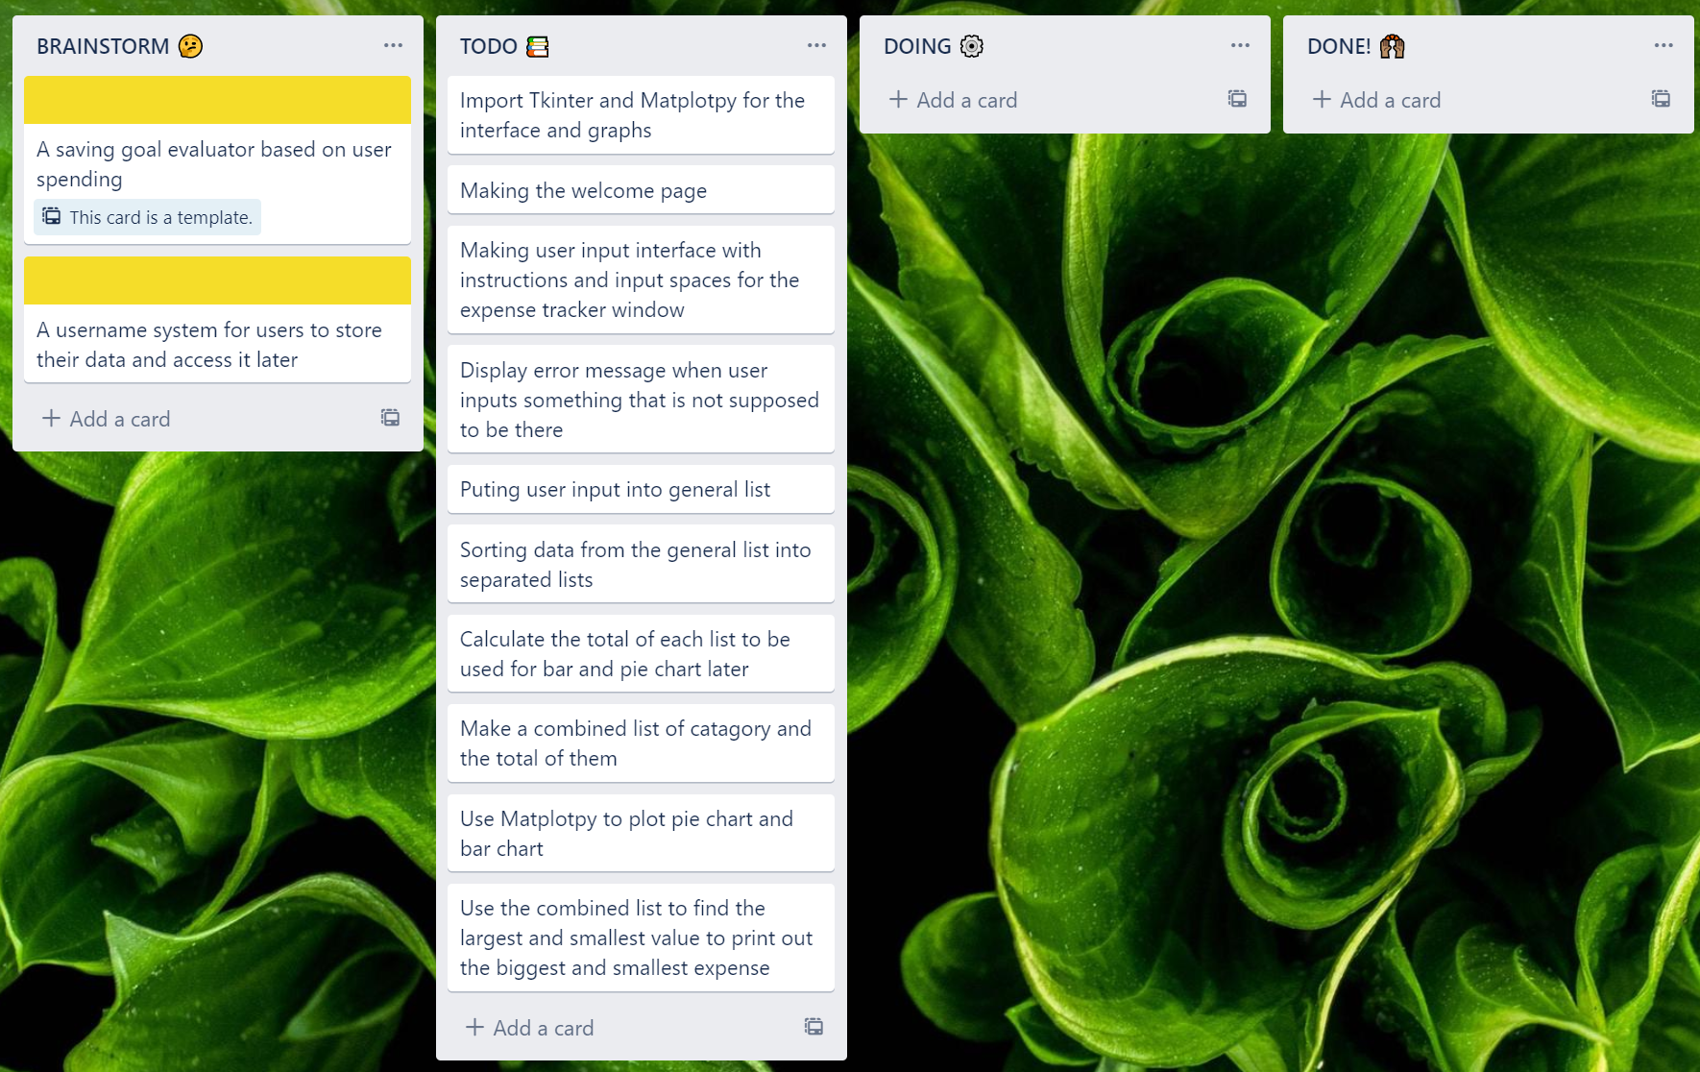
Record evidence that you have setup project management tools to manage the development of your outcome.
I used Trello to manage my project. I broke down my program into small tasks. I put them into the order that I thought would best fit my workflow. This helps me pick up right where I left off when I was working on this project over the course of a month.
I planned to develop my program step by step in the order displayed on the todo tab. This means I don’t have tasks depend on other tasks and other people working on my project so I chose Trello over Gantt. Furthermore, Trello is simple, easy to use and can be shared with other people.

Slide 8
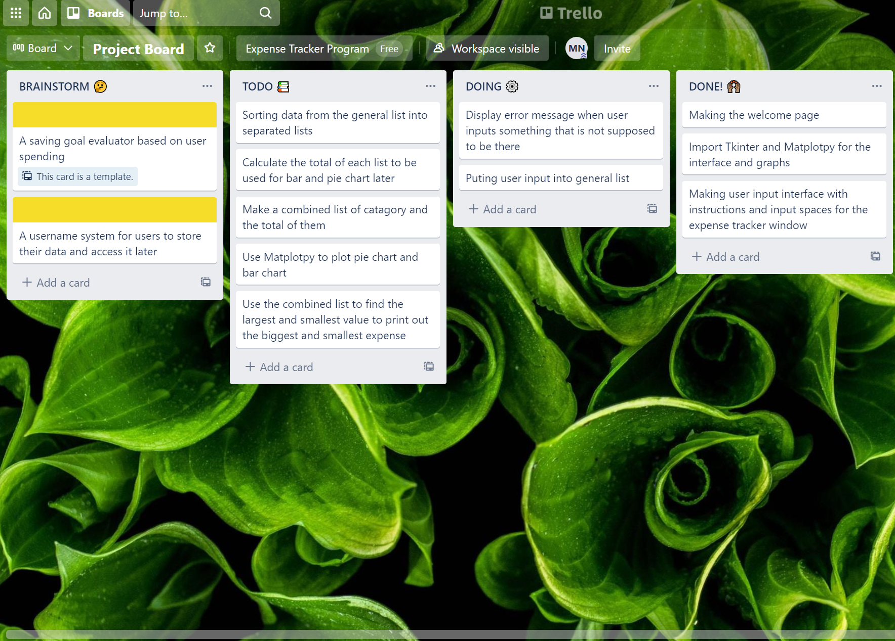
Record evidence that you have setup project management tools to manage the development of your outcome.
As I was working on the project I started moving tasks around. I was still thinking whether to include the saving goal evaluator and username system in the program.

Slide 9
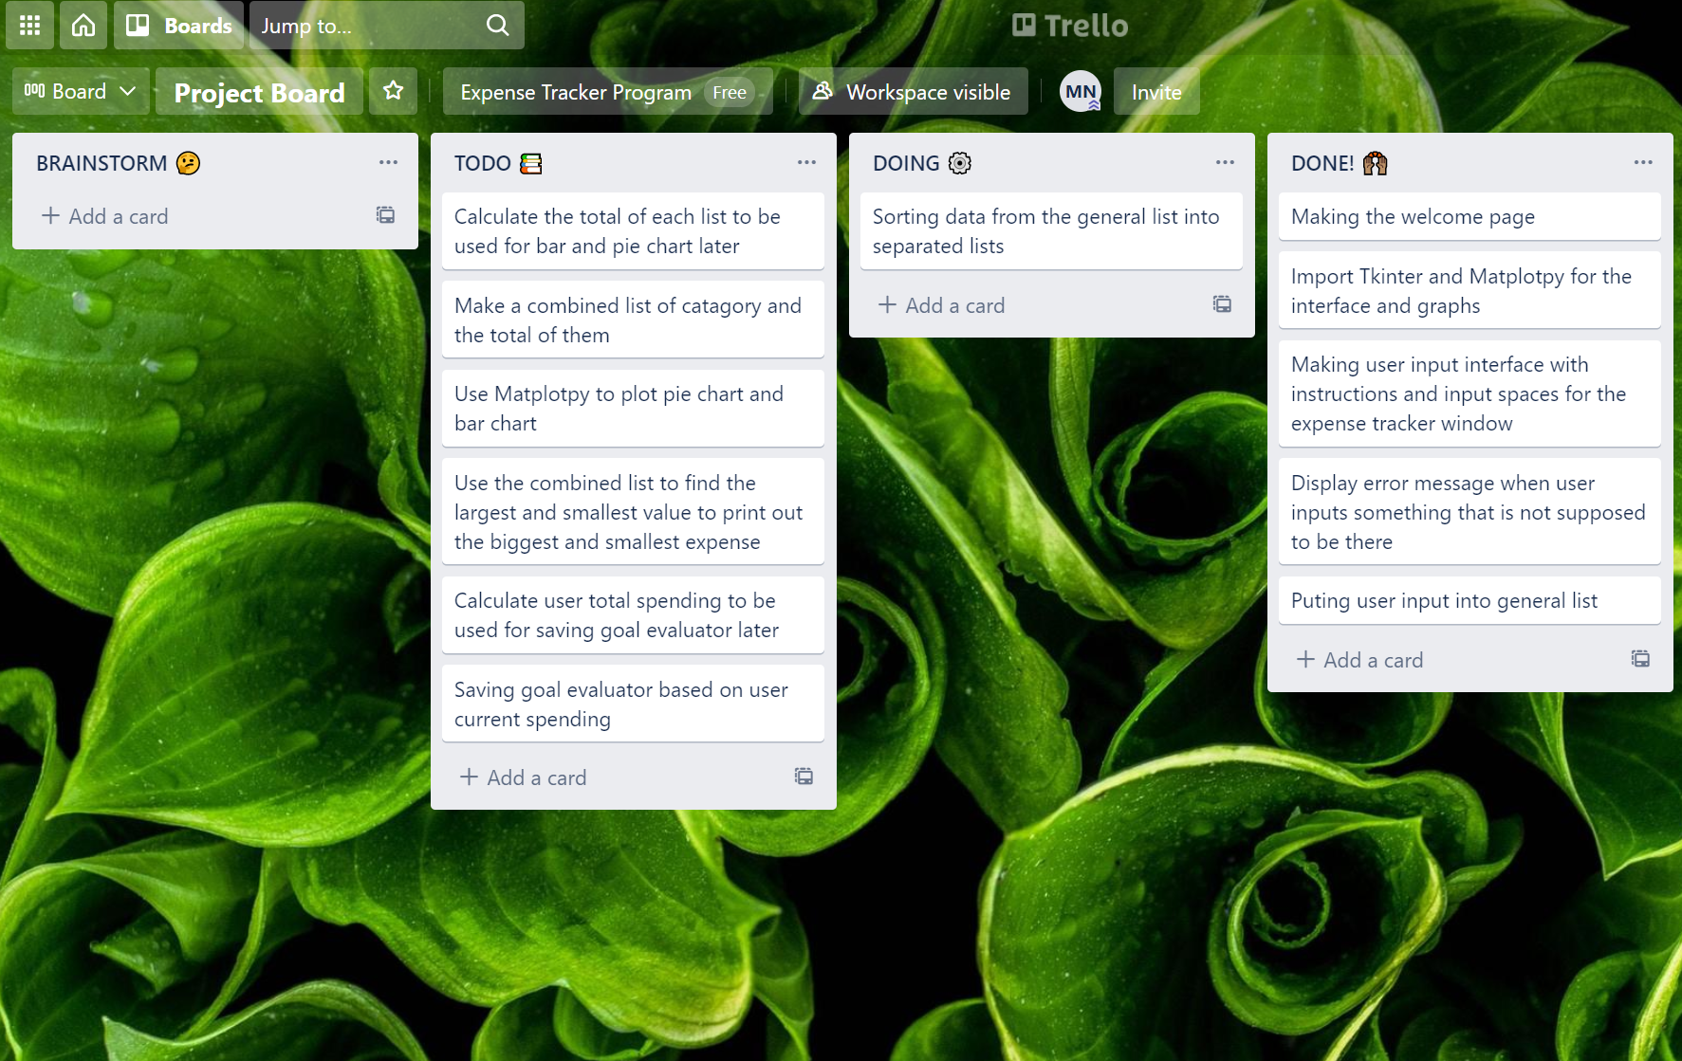
Record evidence that you have setup project management tools to manage the development of your outcome.
I decided to go with the saving goal evaluator idea and scrap the user name system idea so I removed them from the brainstorming tab and I added the tasks for the saving goal evaluator in the to do tab.

Slide 10
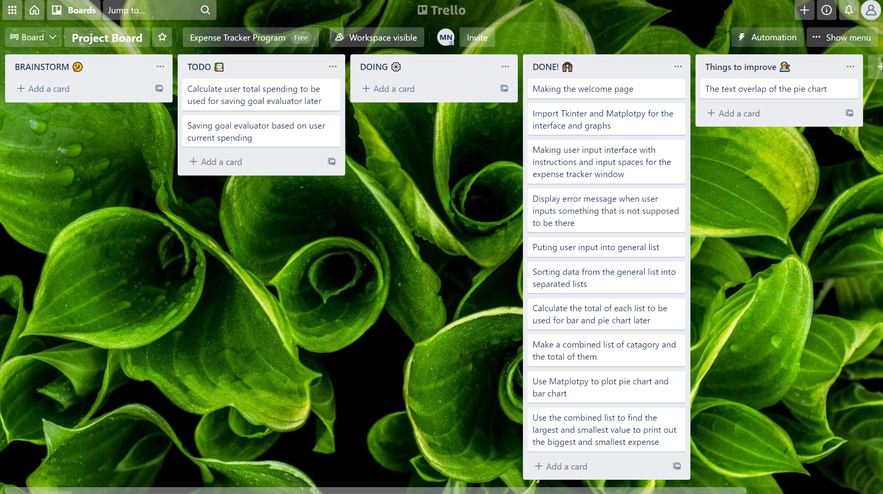
Record evidence that you have setup project management tools to manage the development of your outcome.
I decided to add a improve tab to track things that I should improve to make the program better. The first task of that tab is to fix the text overlap problem of my pie chart.

Slide 11
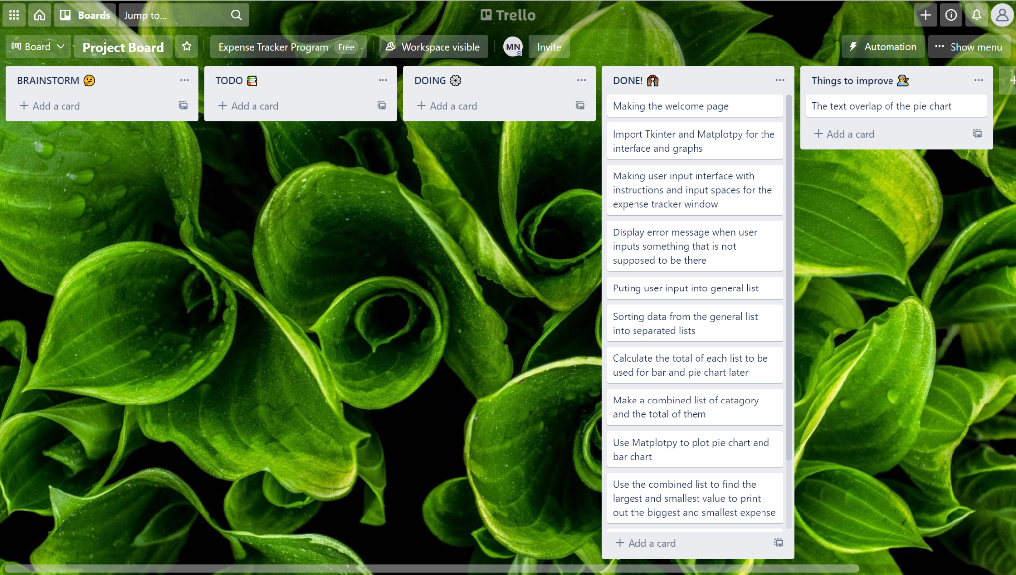
Record evidence that you have setup project management tools to manage the development of your outcome.
Here is what my Trello board looks like when I almost finished my program. Most of the tasks were done. I only had to fix the text problem.

Slide 12
Record evidence that you have chosen project management techniques to manage the development of your outcome.
A project management technique that I used is “Work Breakdown Structure”(WBS). Because this is a big project that can seem overwhelming at first, breaking it down into smaller tasks in an order that is planned in advance helps me stay focused and saves me time thinking about what to work on.
I did this by breaking the project into small tasks and put them on my Trello board and then organized them.
This technique works well with Trello because Trello has archiving feature that I can use to archive my work after completing them.

Slide 13
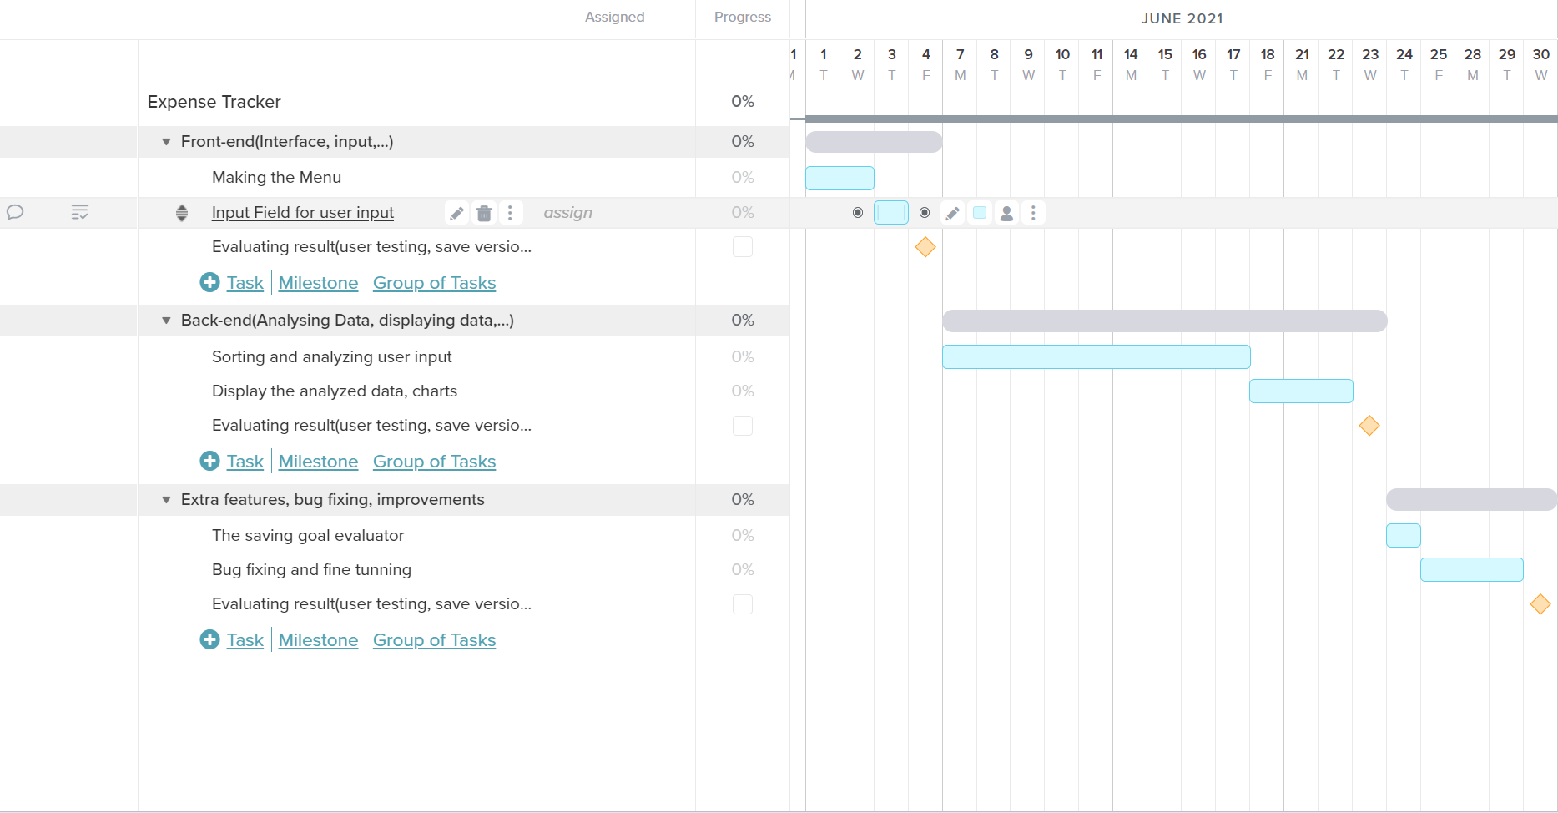
Record evidence that you have chosen project management techniques to manage the development of your outcome.
Another project management method I use is deadlines. This is a Teamgantt task sizing graph using gantt chart that I planned out.This helps me to finish each task on time. This means my developing process can go smoothly and I can hand in the program in time.

Slide 14
Record evidence that you have chosen project management techniques to manage the development of your outcome.
I use the waterfall methodology with a little bit of Agile as I have the testing phase to manage my program. This means I finished each task and test it before moving on to the next.
 | Waterfall | Agile
Plus | Easy to use, good for single project, focuses to project delivery | Helps complete many small projects, focus on customer satisfaction
Minus | Hard to change requirements | Getting user feedback is time consuming
Interesting |  | Works well when work with others
After this comparison, I chose to go with Waterfall method as I’m working on this project by myself. However, I think the testing phase from Agile methodology is important so I also incorporate that into my chart

Slide 15
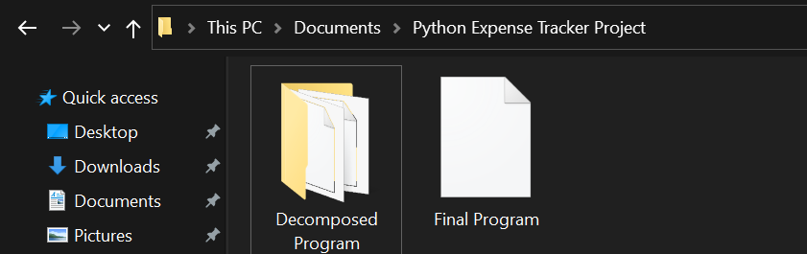
Record evidence that you have setup/ chosen version control tools/techniques to manage the development of your outcome. How you save version etc...
I organise my files using the folder feature in file explorer, the native file organiser in Windows 10. In the main folder, I have a folder that I used to save my decomposed programs and the final program when combined all the decomposed parts together.

Slide 16
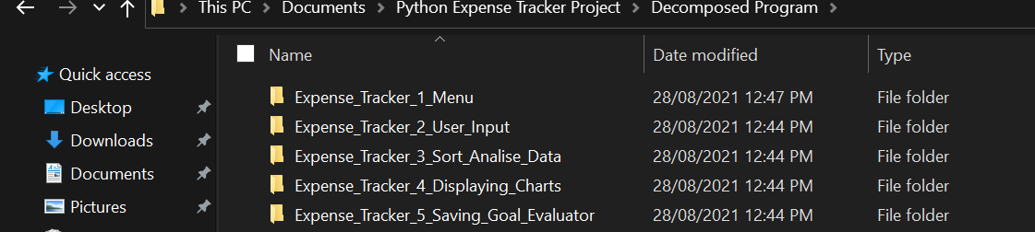
Record evidence that you have setup/ chosen version control tools/techniques to manage the development of your outcome. How you save version etc...
I coded each version as a seperated program that can run individually on its own based on how I decomposed my program. I then combined them to get the final version. I saved each part after I finished coding and testing the versions, bug fixing and gave the decomposed part to user to test. This is to make sure that each version runs well and can work well when combined to be the final version.

Slide 17
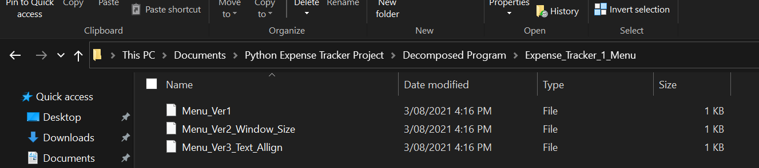
Record evidence that you have setup/ chosen version control tools/techniques to manage the development of your outcome. How you save version etc...
Within each decomposed part, I use the local version control system to manage my versions. I save a new version when I make changes to the original code. The screen shot shows the three versions I have for the Menu part of my program. I saved them as version number and the changes I made in that version. I chose this technique as it is easy to use because I’m already familiar with file explorer, the native file management tool of Window. This technique also allows me to make changes and test each part individually. If I make a mistake or don’t like a feature, I can always go back to the previous version.

Slide 18
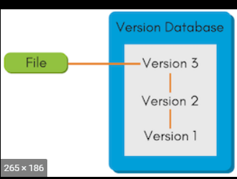
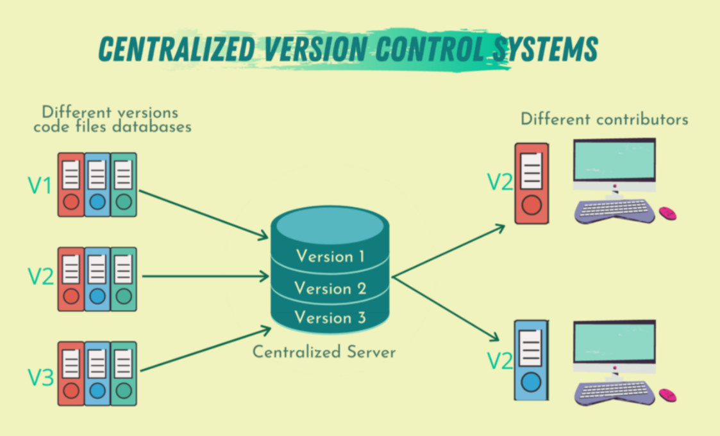
Record evidence that you have setup/ chosen version control tools/techniques to manage the development of your outcome. How you save version etc...
When I was deciding on what technique to use, I compared between “Local Version Control” and “Centralized Version Control Systems”
 | Local | Centralized
Plus | Easy to use, time saving | Easy to collaborate, cloud
Minus | Can’t collaborate with others | Takes time to learn
Interesting |  | Many online tools
I decided I would go with the Local Version Control system as I would have more time developing my program and I’m working on this project myself so I don’t need to share it with a lot of people.

Slide 19
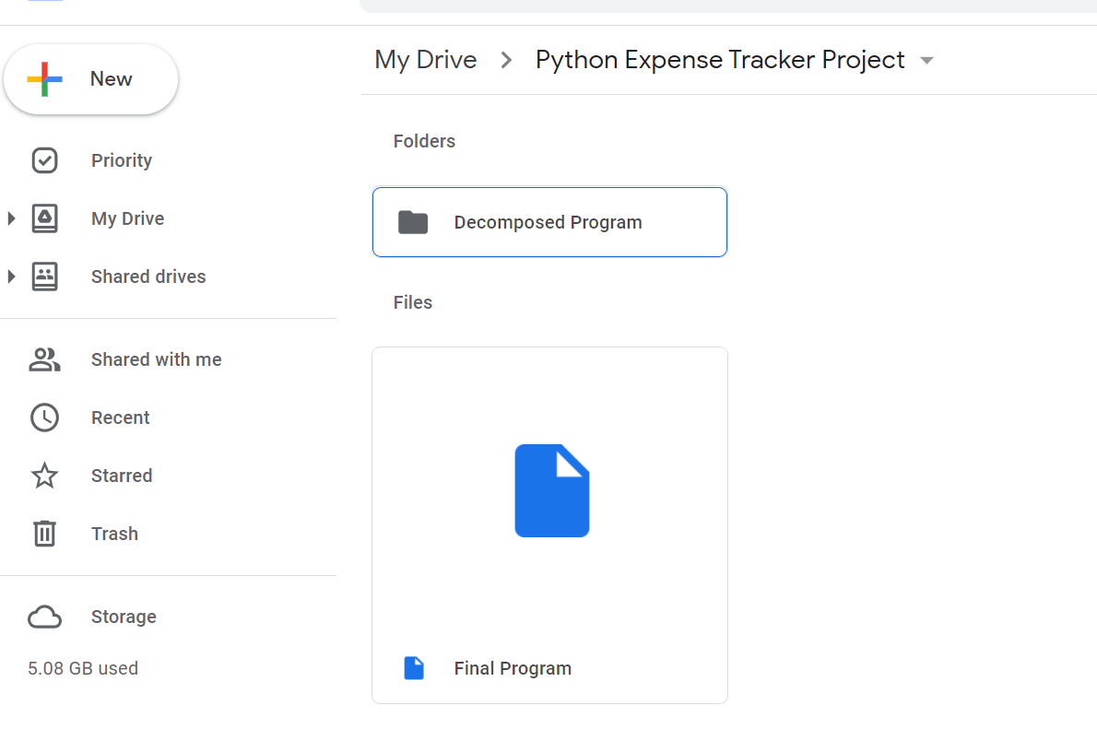
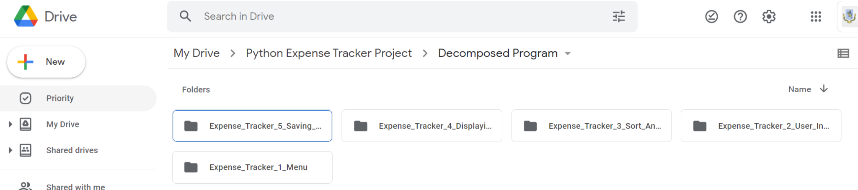
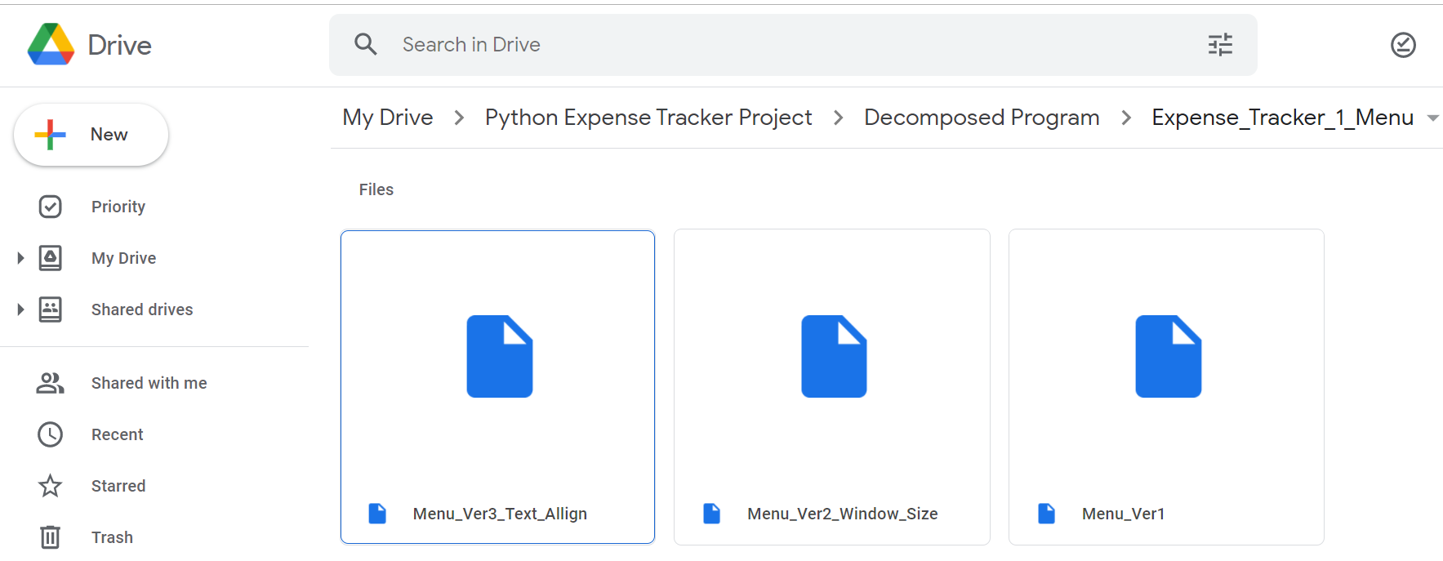
Record evidence that you have setup/ chosen version control tools/techniques to manage the development of your outcome. How you save version etc...
I also saved the versions on google drive so that I can easily share my work with other people using the google ecosystem. In addition, this is another backup in case anything goes wrong on my computer or I have to work on my program using a different computer.

Slide 20
Explain why you believe that these tools and techniques are appropriate for the development of your outcome.
I believe these tools and techniques are appropriate for the development of my outcome as they help me to work more productively and efficiently. For example, the Trello board helps me to stay organized and on task through the list of tasks that I set out before. I will know exactly what to do at any given time and the deadlines of when I have to complete by. The local version control system helps me to easily make changes and test different ideas in my program more efficiently. I know exactly what each version of decomposed part do and if I don’t like them I can always go back to the previous version. The testing also helps me ensure each part works without bugs so that they would work as intended when combine into the final program.

Slide 21
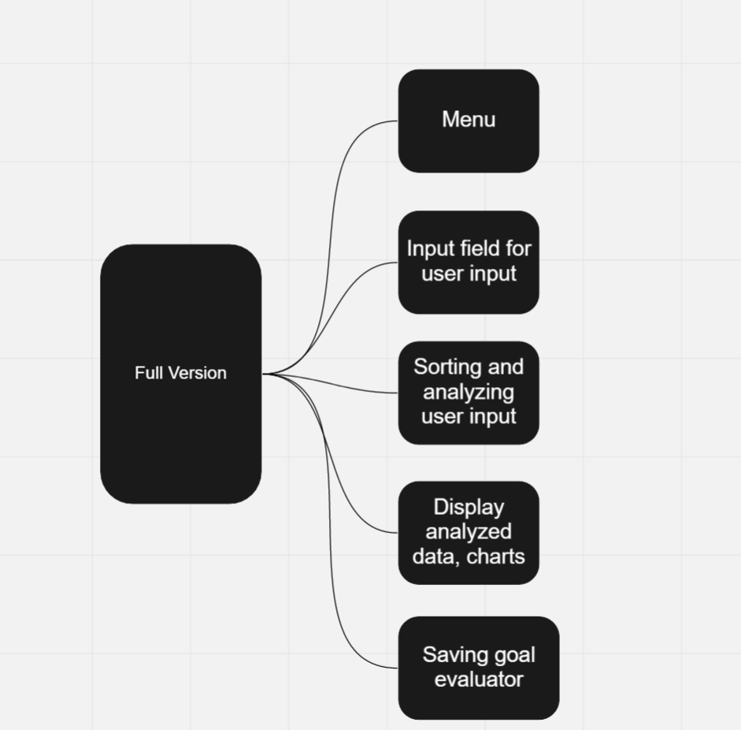
Decomposing outcome
I have decomposed my program into smaller parts using a white board tool called Miro. This helps me understand what I have to do on a better level as the complex problem is now broken down into more manageable parts.

Slide 22
Decomposing outcome
Then I break down the decomposed parts into even smaller achievable tasks and put it on my Trello board. This is so I know exactly what to do and don’t waste time organizing tasks.

Slide 23
Decomposing outcome
I then moved the task according to how I’m completing them

Slide 24
Decomposing outcome(Task sizing)
After I have decomposed my program, I also plan out a Teamgantt task sizing graph using gantt chart based on my estimation of how long it would take me to complete each decomposed part. Since I have to finish one component before moving on to the next one, the chart also appears to have characteristic of the waterfall project management method.
This task sizing graph provides me with time targets and milestones I have to hit on certain dates.

Slide 25
Decomposing outcome(Task sizing)
After finishing one or two parts, I always have a day where I can evaluate the result. I use that day to get user to test the program, do bug fixing to make sure that the part works well individually. I also do project administration tasks such as saving version and organising files on that day.

Slide 26
Trialling components
Record evidence that you have trialled components. Show that you gathered information to inform your decision making.
Record evidence that you have trialled multiple components and have selected those most suitable.
Record evidence that you have used information from trialling appropriately to improve the functionality of the outcome.

Slide 27
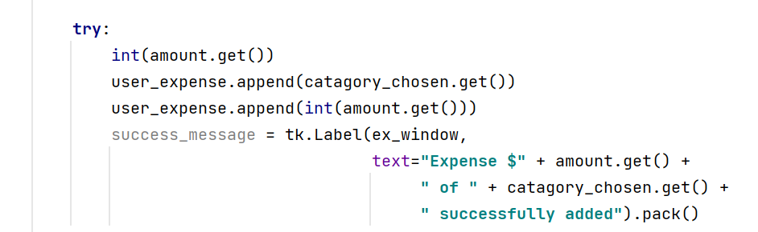
Trialling components (Record evidence that you have trialled components. Show that you gathered information to inform your decision making.)
Throughout the process of developing my program, I trialled different features or functions to my program in order to see which one fits the best.
For example, in the sorting and analysing part of my program, I have a function to test if the user input is valid or not. Initially, I turn the user input to integer.
When my friend Bill put in a decimal number as his money amount, the program returns error. I realized the user input for my program is money amount. As a result, the input is not always gonna be integer number. Therefore, I have to try different data type to see which one fit best

Slide 28
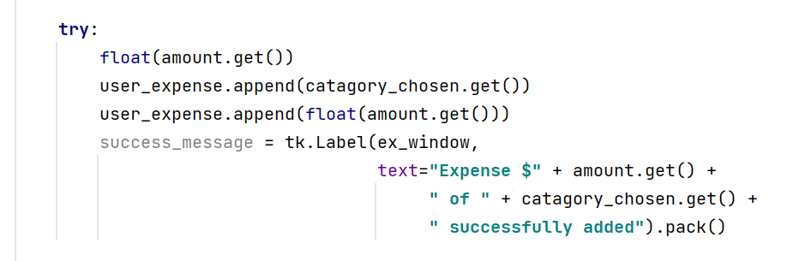
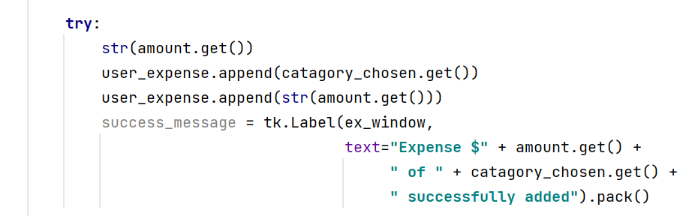
Trialling components (Record evidence that you have trialled multiple components and have selected those most suitable.)
I trialled the with different data types such as “float” and “str”. String is not suitable for my program as I want to manipulate the user input later. Float is suitable for my program as it allows me to manipulate user input later and also accepts decimals.

Slide 29
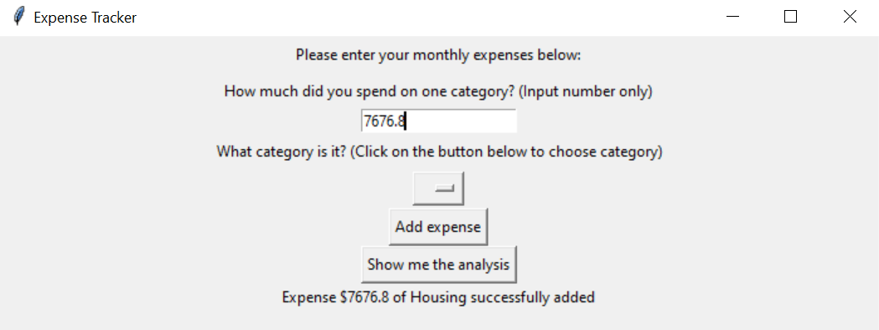
Trialling components (Record evidence that you have used information from trialling appropriately to improve the functionality of the outcome.)
From my trials, I decided to convert the user input to float. The outcome is as I expected, I was able to input amount of money with decimal.

Slide 30
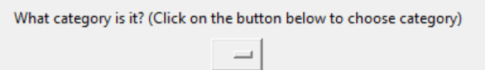
Trialling components (Record evidence that you have trialled components. Show that you gathered information to inform your decision making.)
I also trialled separated buttons for category instead of one drop down button
 | Drop down | Button
Plus | Space saving, aesthetic | Easier for user to click(less steps)
Minus | Might confuse some user | Takes up a lot of space
Interesting | Can store large number of options but only take up space of one button
From my own comparison and feedback from users, I decided to go with drop down button. My friend Bill suggests me to explain what user have to do in a bracket to make it more clear. After that I tested my program with other people and no one seemed to be confused/

Slide 31
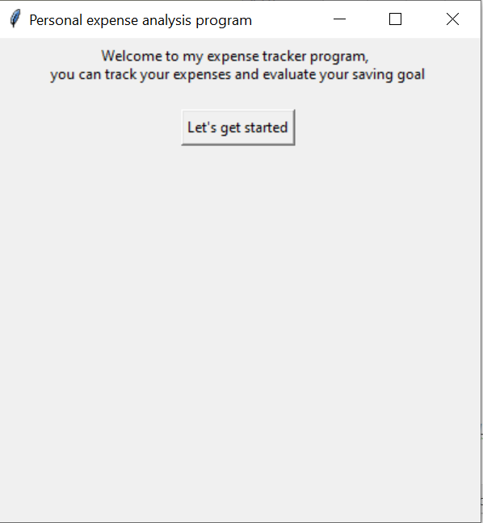
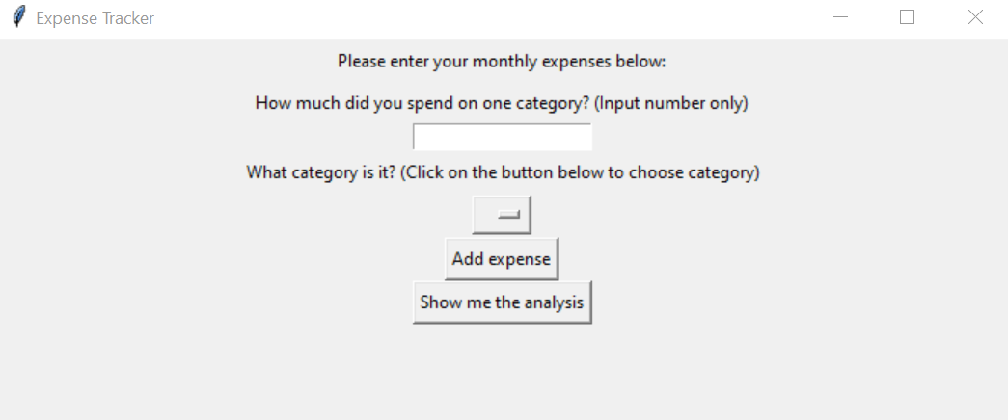
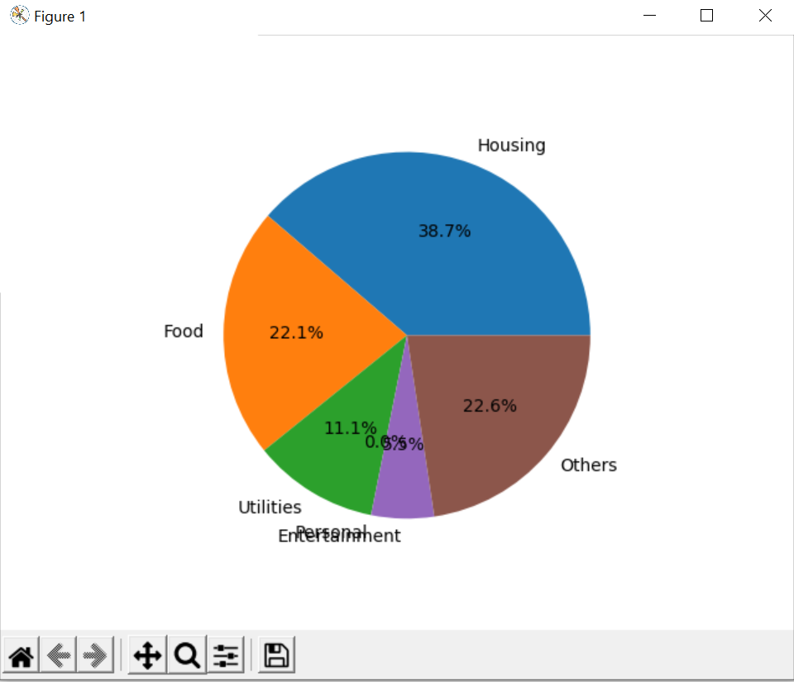
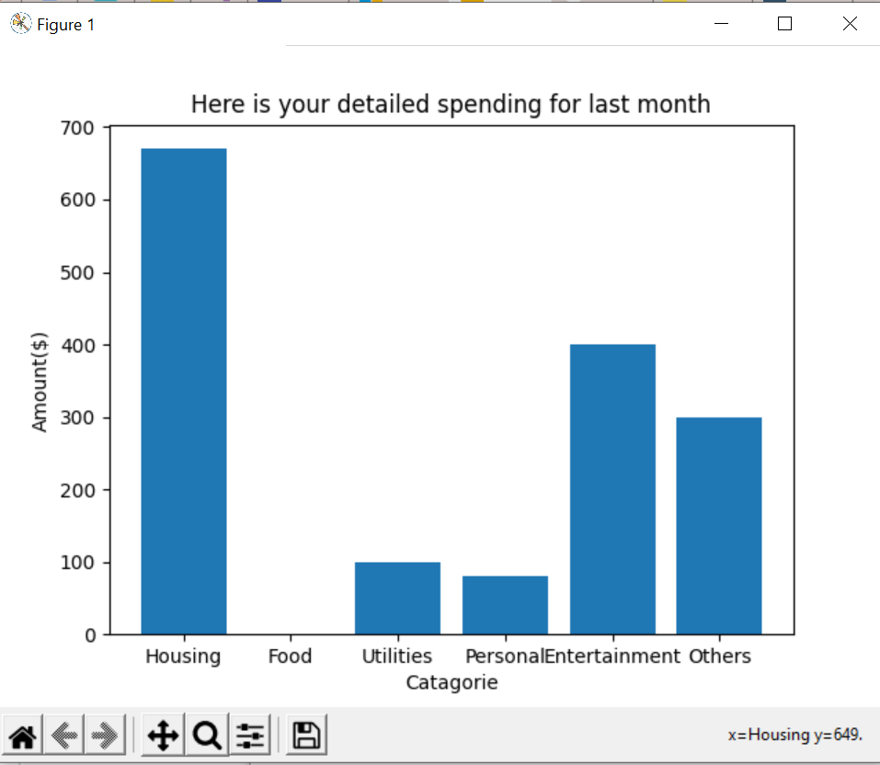
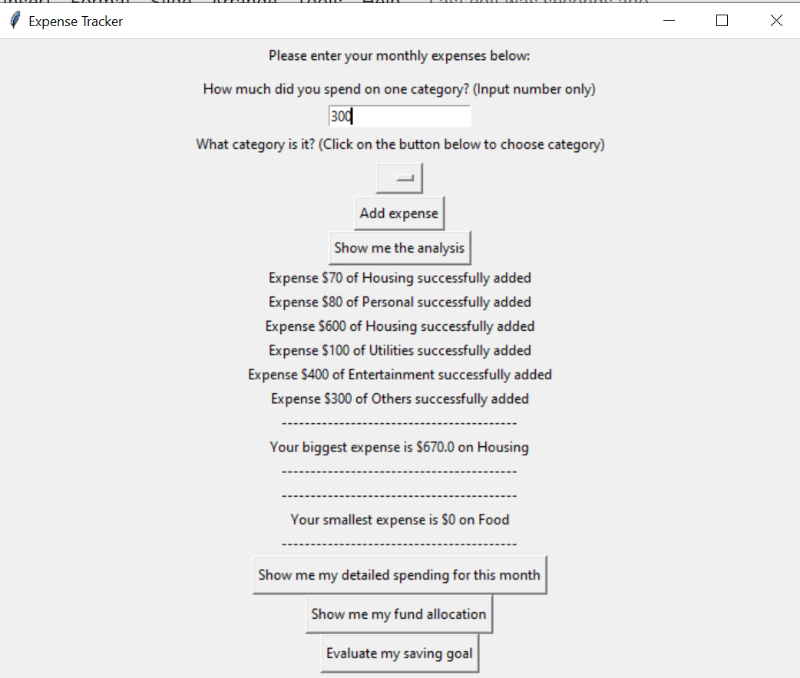
Testing outcome(Record evidence that you have tested your outcome. )
I gave the program to my friend to run with different inputs and combinations to see if it works well or not

Slide 32
Testing outcome(Explain how the testing made sure your outcome functions as intended to meet its purpose and requirements.)
User testing and testing overall allows me to see bugs and errors that I can’t identify myself and gives me suggestions for new features in my program. This ensures that my decomposed parts work well individually and my program meets its purpose of serving the my target audience.

Slide 33
Testing outcome(Record evidence that you have used information from testing appropriately to improve the functionality of the outcome.)
After I gave my program to my friend Anh, he suggested me to include a pie chart that shows the fund allocation as he thought it would be helpful. I then added that function in the program.

Slide 34
Testing outcome(Record evidence that you have tested your outcome. )
I also tested the program through running the program with different inputs and combinations to see if it works well or not. Below is a testing table that I made
Test number | Test type | Test Data | Reason | Expected Outcome | Actual Outcome | Pass/fail
1 | Valid | Money = 1.234 | Enter a decimal to see if it’s valid | Valid | Valid | Pass
2 | Valid | Money = 1234 | Enter a decimal to see if it’s valid | Valid | Valid | Pass
3 | Invalid | Money = 123A | Enter a character to see if it’s invalid | Invalid | Invalid | Pass
4 | Null | Money = nothing entered | To see if it will ask user to enter something | Ask for input | Return Error | Fail

Slide 35
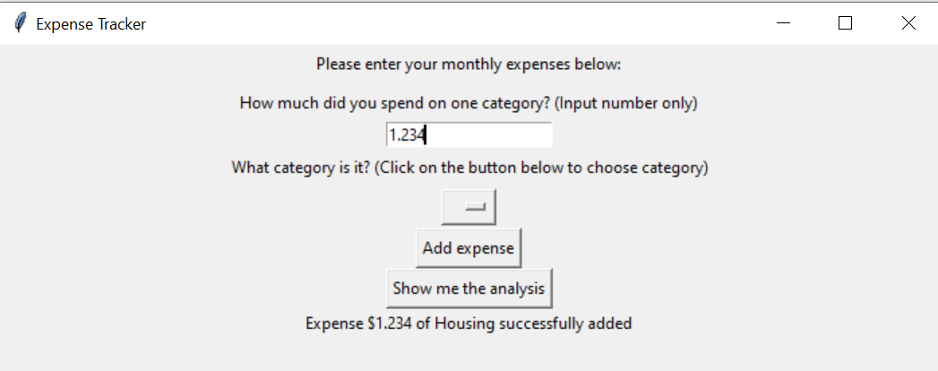
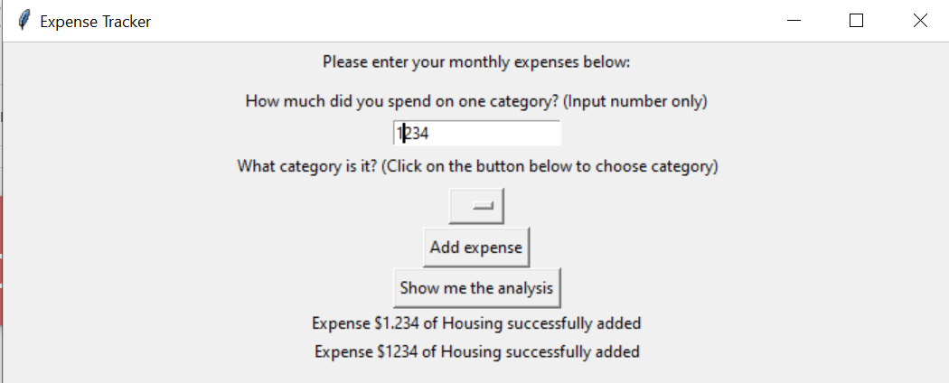
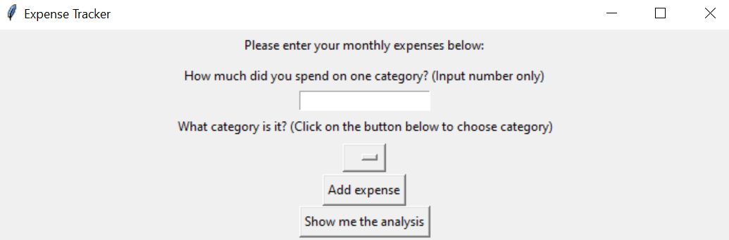
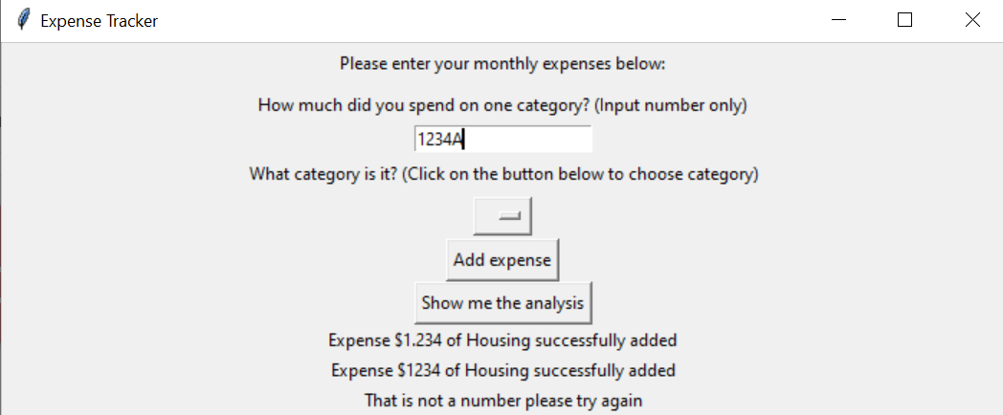
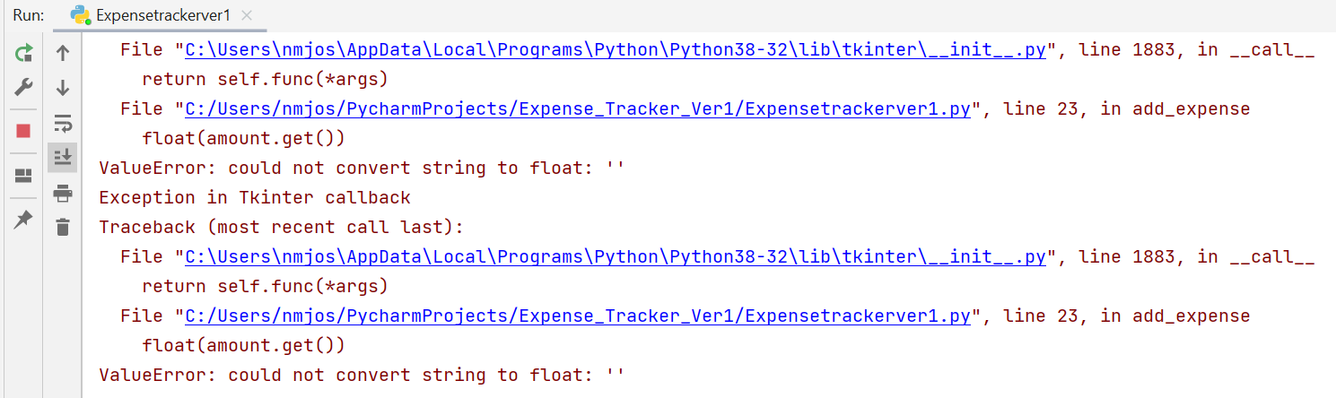
Testing outcome(Record evidence that you have tested your outcome. )
Here are the screenshots of my testing

Slide 36
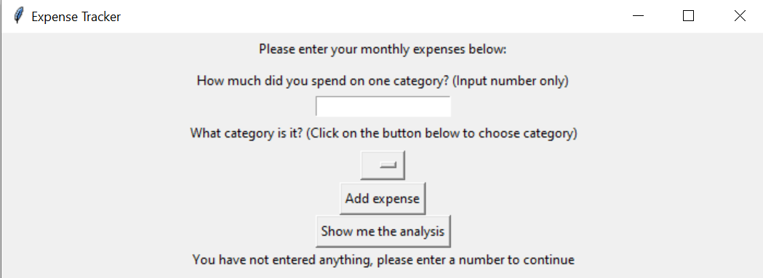
Testing outcome(Record evidence that you have used information from testing appropriately to improve the functionality of the outcome.)
I then make it so that if the user doesn’t enter anything and press the analysis button, the program will say”You have not entered anything, please enter a number to continue”

Slide 37
Project management: Applied
Record evidence that you have used your project management tools to manage the development of your outcome.
Record evidence that you have used your project management techniques to manage the development of your outcome.

Slide 38
Project management: Record evidence that you have used your project management tools to manage the development of your outcome.
I only use 2 project manage tools to manage my outcome, Trello and Gantt chart. My Trello Board link is https://trello.com/invite/b/1EqrZnHl/cffb8906c471631e19c88b44aa97d4b1/project-board

Slide 39
Project management: Record evidence that you have used your project management techniques to manage the development of your outcome.
My project management method is the Waterfall method with characteristics of Agile method. I also implement the work breakdown structure method and deadlines in my project.
Work breakdown structure
Waterfall method & Deadlines & Testing

Slide 40
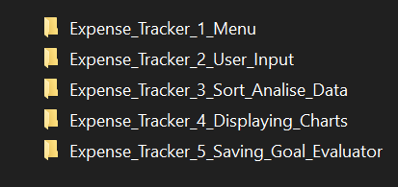
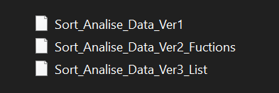
Version Control
I save each part individually
I wanted to test and improve each part individually, so I implement local version control method for each of my part
I save each version when I make significant change. I save them as version 1,2,3 and so on follow by the characteristic that I changed for that version

Slide 41
Relevant Implications(do 4)
Explain the relevant implications here. Please watch this video to learn how to do this.
Explain the Implications that are relevant to your outcome.
Record evidence that you have addressed the Implications that are relevant to your outcome.

Slide 42
Relevant Implications(do 4)
Cultural Implication
Cultural implication means the program must not be offensive to any culture or country. This means the program must not have hate speech, racism, stereotypical representation in any shape or form
In my program
I have checked the texts and features of my program carefully to make sure that it doesn’t offend any culture. To be sure, I asked my friend from different backgrounds to have to look at my program and point out any features that can be considered culturally inappropriate. After that, we found out that my program didn’t have any.

Slide 43
Relevant Implications(do 4)
Usability
This means the program is designed with end user in mind so that it is easy to use and access by the end user
In my program
When I design my program, I tried to make everything as simple as possible. The program usually only have one or two buttons each window so that it doesn’t seem intimidating to use. I also tried to give user clear instructions by using brackets to clarify such as (How much did you spend on one category? (Input number only))

Slide 44
Relevant Implications(do 4)
Sustainability and future proofing
The program must be easy to modify and add new features so that I can continuously improve the program to better serve my target audience in the future.
In my program
I sorted user inputs into separated categories lists, they are saved as float in each separated category. This allows me to easily manipulate the data later incase I want to add any new feature.

Slide 45
Relevant Implications(do 4)
Legal
This means the program complies with laws and regulations imposed by local government and standards on where the program is published.
In my program
I follow all rules and regulations by New Zealand Government when I made my program. As far as I know, I don’t break and laws

Slide 46
Evaluate
I used Trello as my task management tool. This saves me time looking at what to do and helps me stay on task. As a result, I didn’t run out of time and handed in a complete and successful outcome.
I used Gantt chart to set deadlines based on my estimation of workload. This shows me how much time I have left to complete a given task and what’s the next task I have to complete. As a result, I was able to finish everything on time and hand in a successful outcome.
I used the local version control system to manage changes I made to the program. This allows me to stay organized and track exactly what I change. This let me test different ideas and trial different features in my program. As a result, I was able to improve and implement different features to make a more complete finished product.
I also user tested my decomposed part after I finished them. This allows me to fix bugs, add new features and ensure each part works as intended before combining together. As a result, I was able to make my final program by combining decomposed program together.
If I could do it again, I would change the user interface of my program. I think it functions well, however, the interface looks outdated and doesn’t resonate with the new generation of user.

